Slide 1
Markov chains
CS5330: Randomized Algorithms
Lecture 8
10/03/2020

Slide 2
Admin stuff
Week 7 problem set out (on hashing)
Midterm grades will be out by next week
Please fill out mid-semester student feedback questionnaire.

Slide 3
Final Project
Please take a look at the instructions for the final project on LumiNUS. If you have other topics you want to work on, ask me.
This is an editable google doc I have put up that you can use to form groups: http://tiny.cc/oz72kz
You need to let me know your team members and project topic by this Friday.

Slide 4
Today’s Agenda
Hashing: review of lecture on hashing
Markov Chains: definitions, random walks on graphs, some applications.

Slide 5
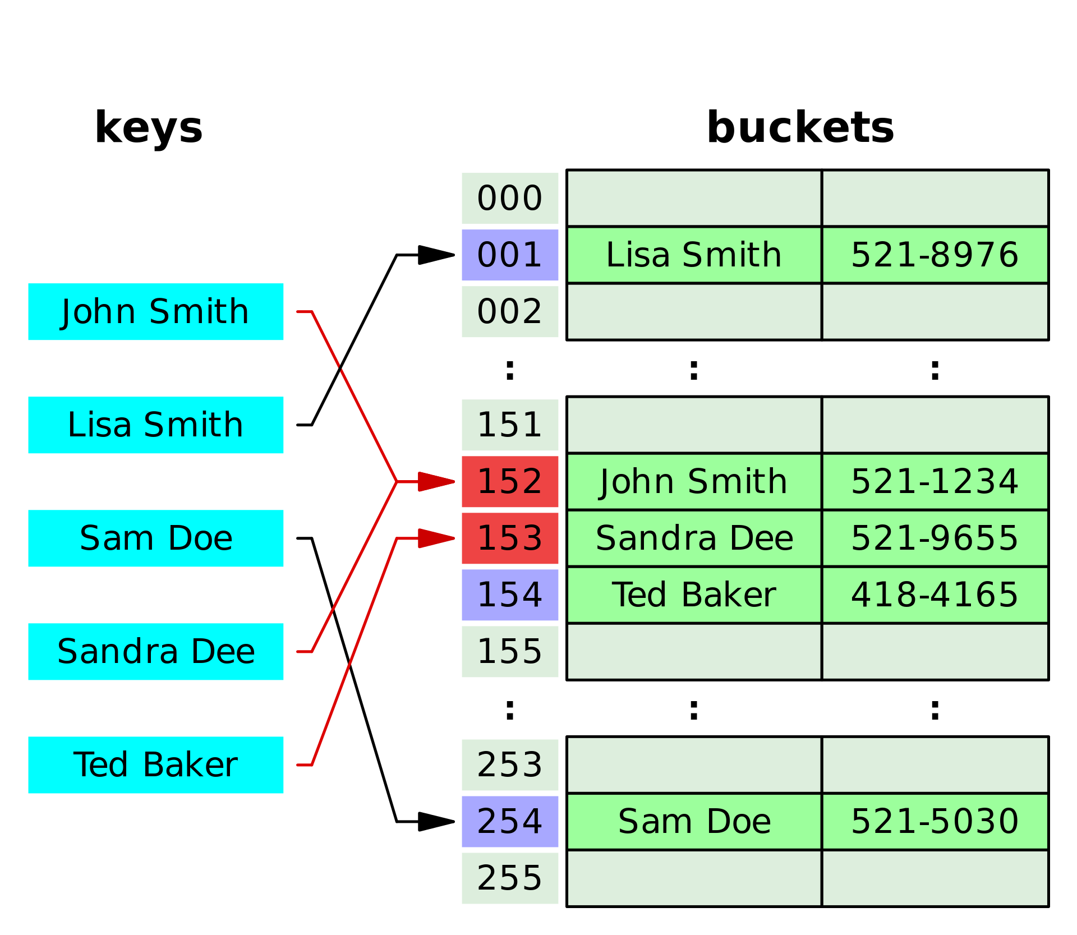
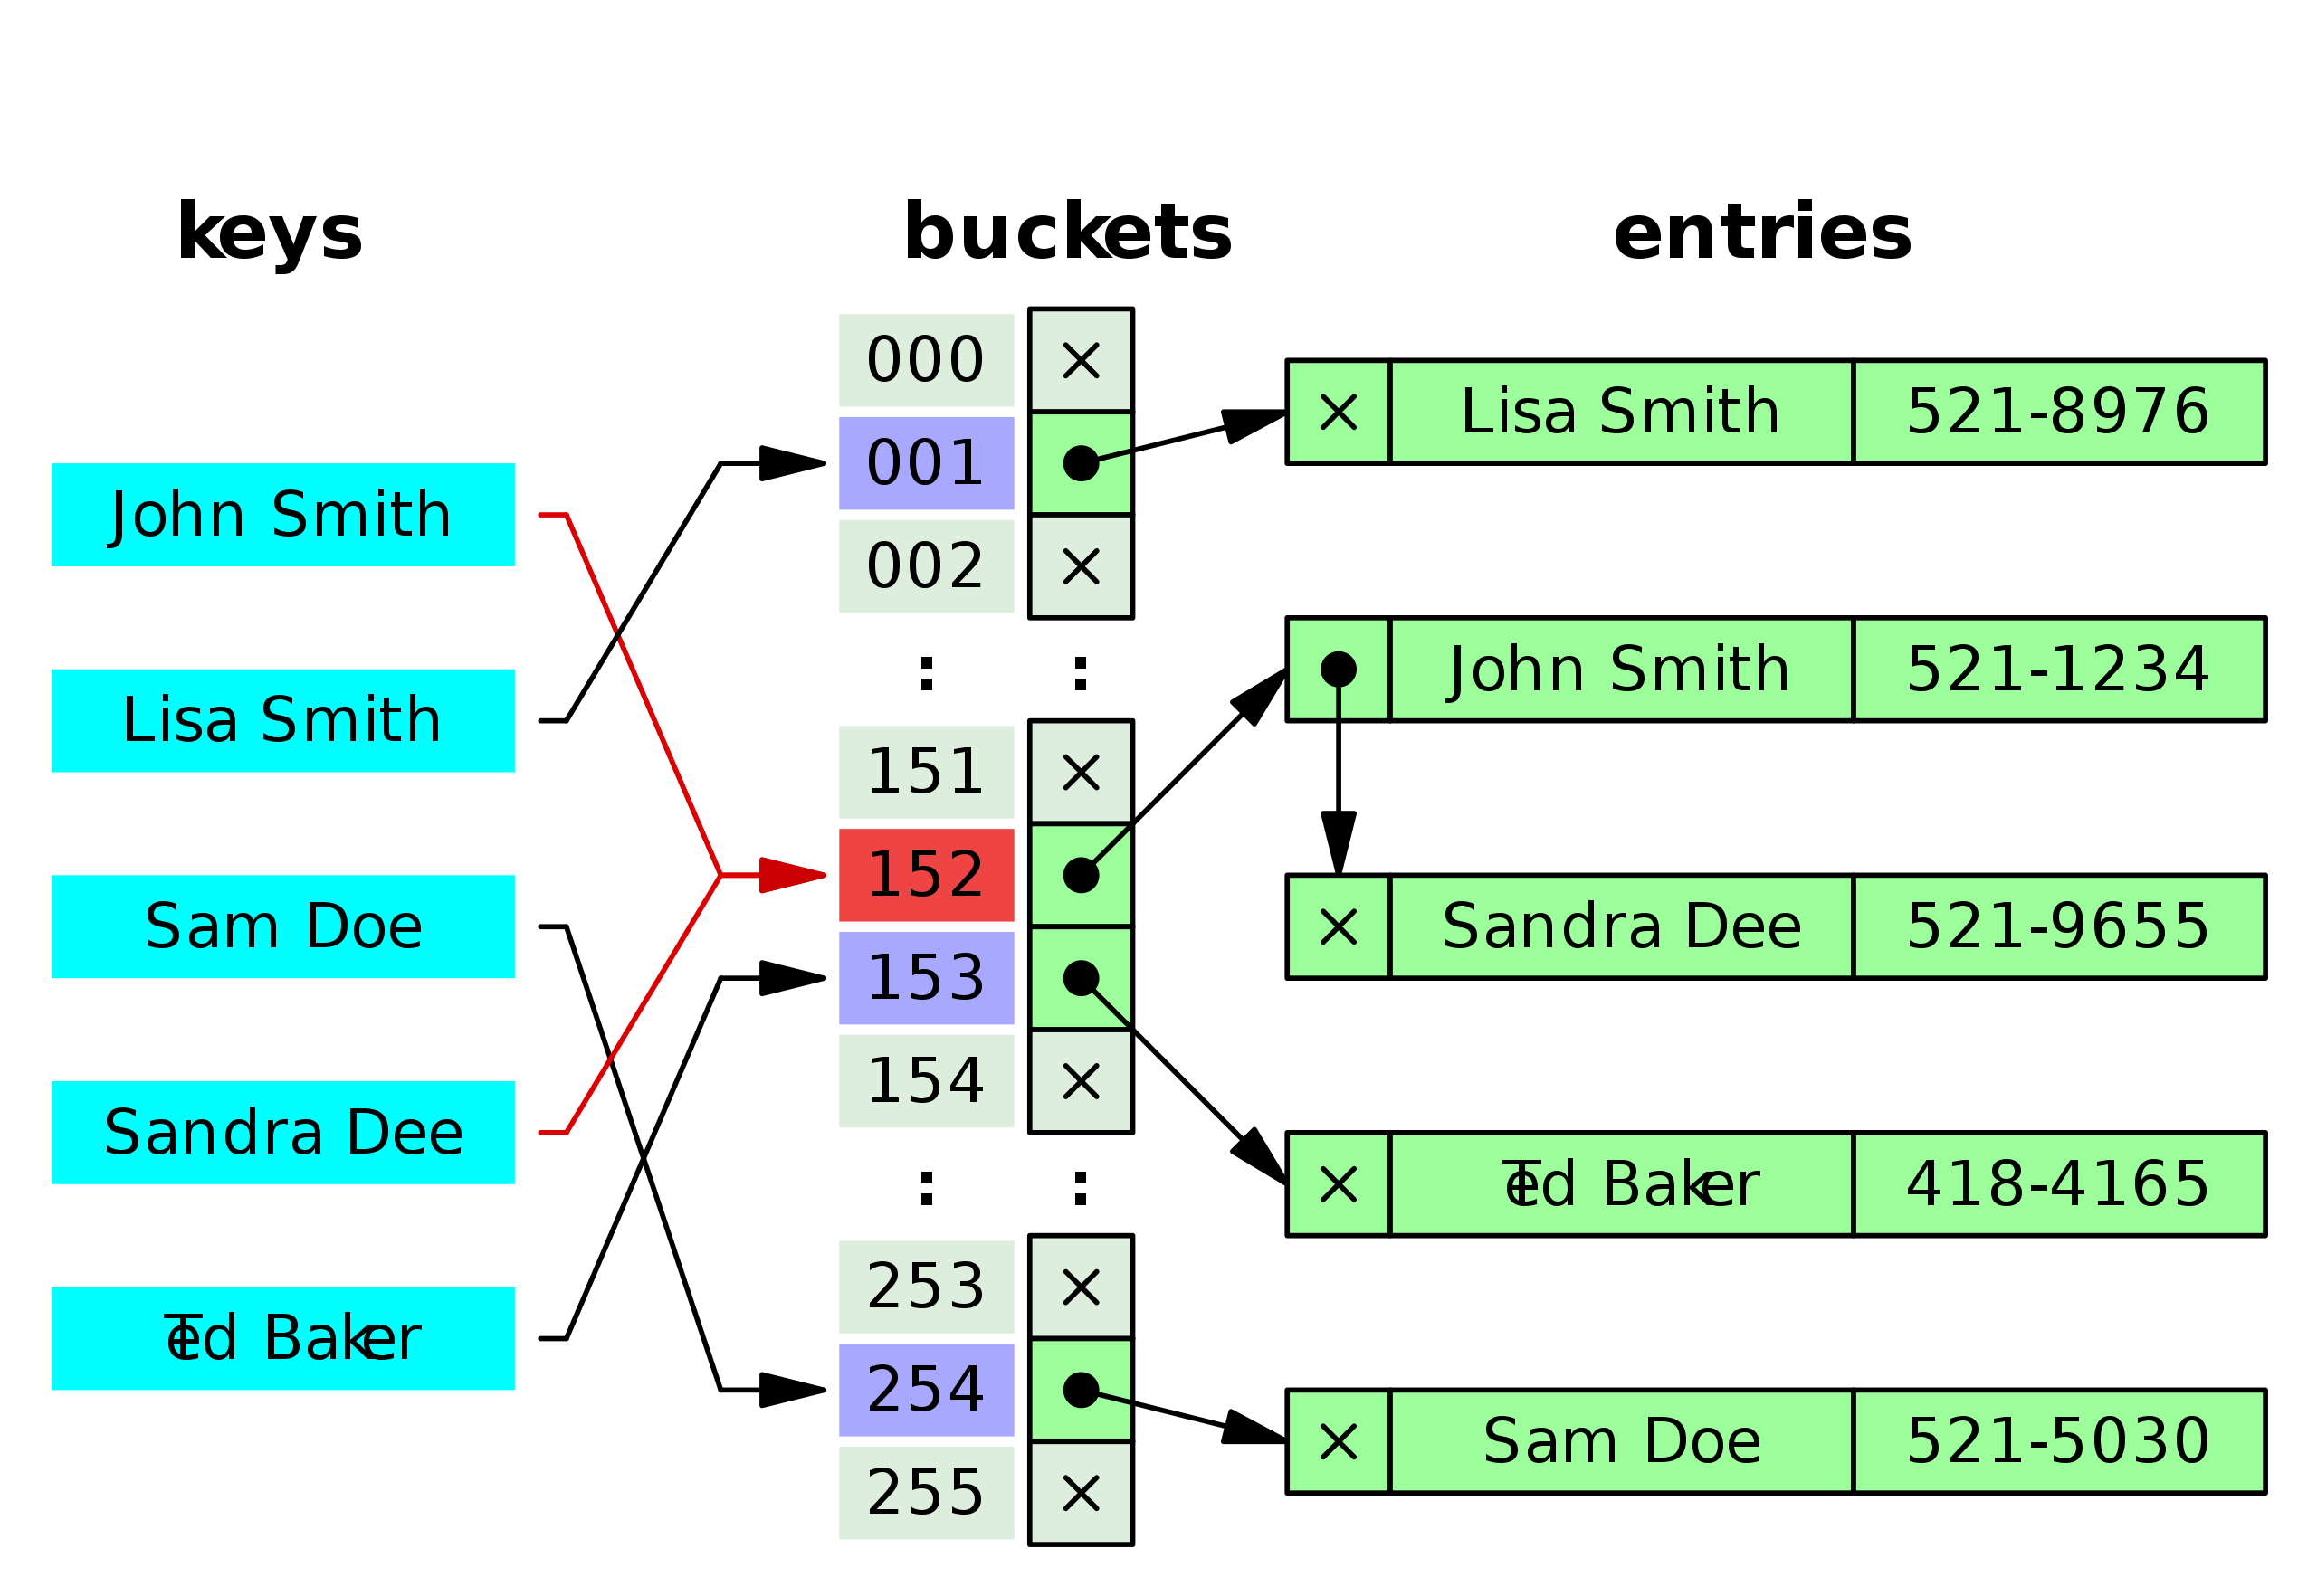
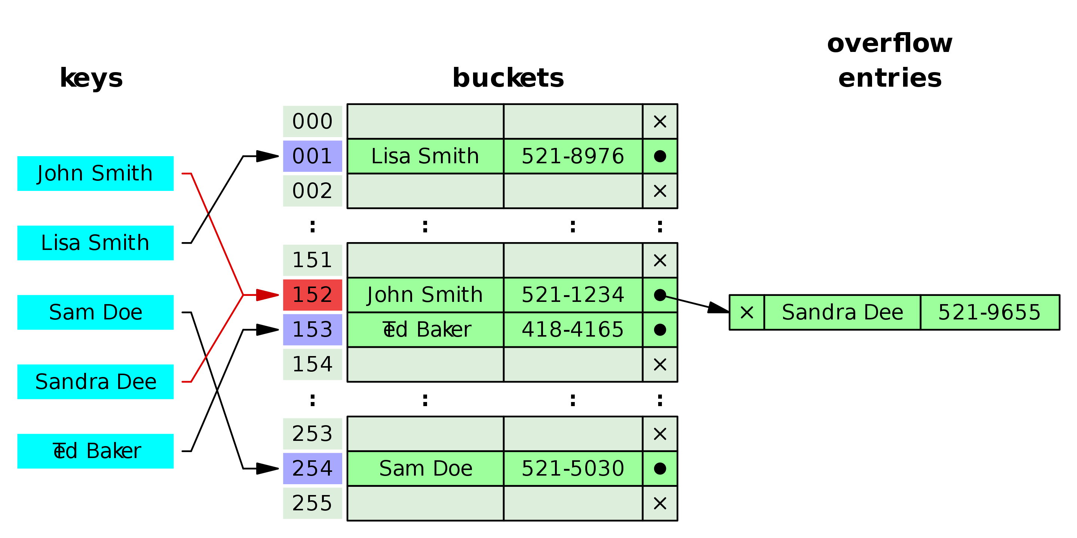
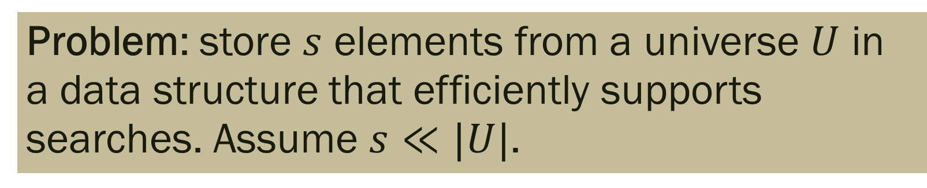
What is Hashing?
Problem: store $s$ elements from a universe $U$ in a data structure that efficiently supports searches. Assume $s≪|U|$.

Slide 6


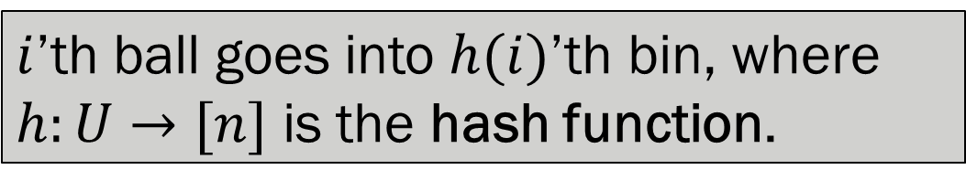
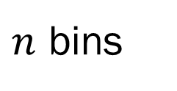
Balls and Bins
$s$ balls
$n$ bins
$i$’th ball goes into $h(i)$’th bin, where $h:U→[n]$ is the hash function.

Slide 7
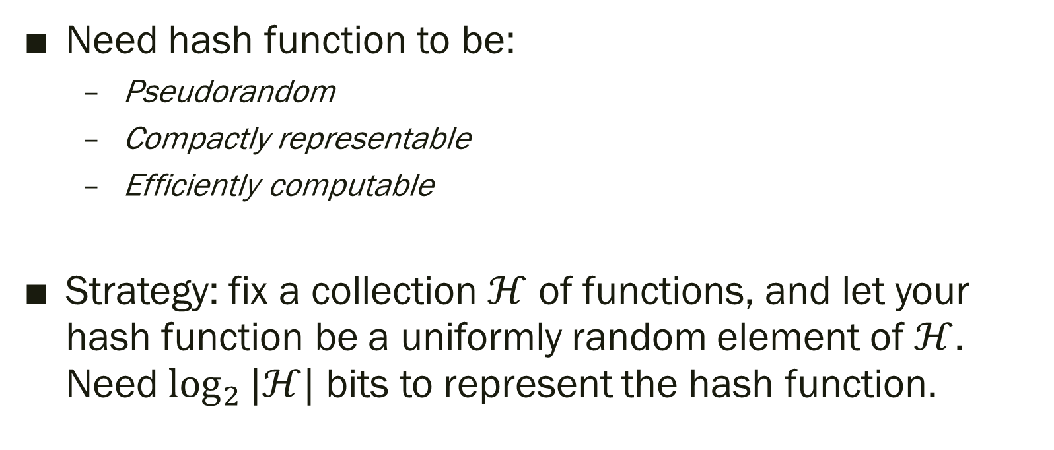
How to choose the hash function?
Need hash function to be:
  Pseudorandom
  Compactly representable
  Efficiently computable
Strategy: fix a collection $ℋ$ of functions, and let your hash function be a uniformly random element of $ℋ$. Need $\log_{2}{|ℋ|}$ bits to represent the hash function.

Slide 8
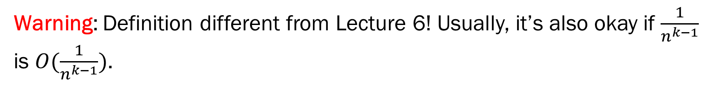
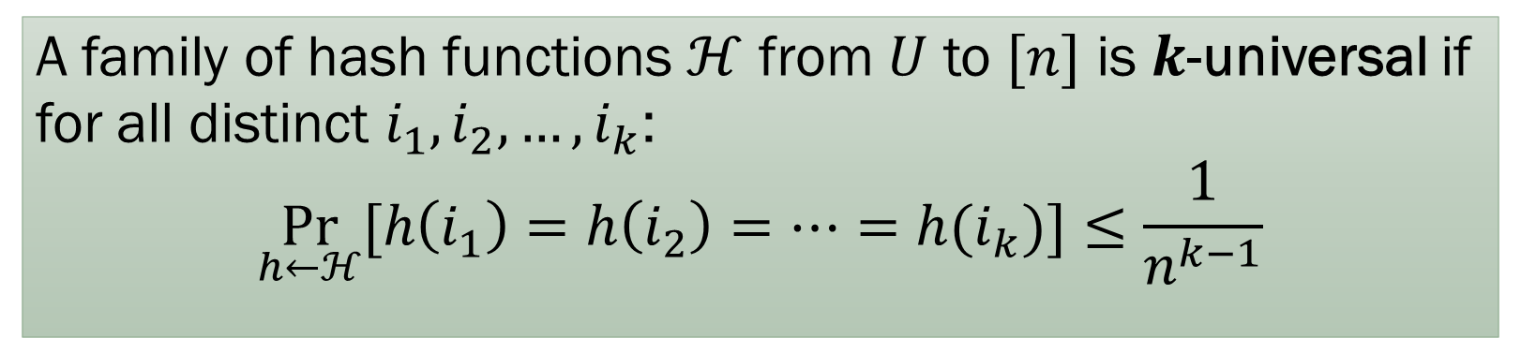
Universality
A family of hash functions $ℋ$ from $U$ to $[n]$ is $k$-universal if for all distinct $i_{1},i_{2},…, i_{k}$:
$$\underset{h←ℋ}{Pr}{[h\left(i_{1}\right)=h\left(i_{2}\right)=⋯=h(i_{k})}]≤\frac{1}{n^{k−1}}$$
Warning: Definition different from Lecture 6! Usually, it’s also okay if $\frac{1}{n^{k−1}}$ is $O(\frac{1}{n^{k−1}})$.

Slide 9
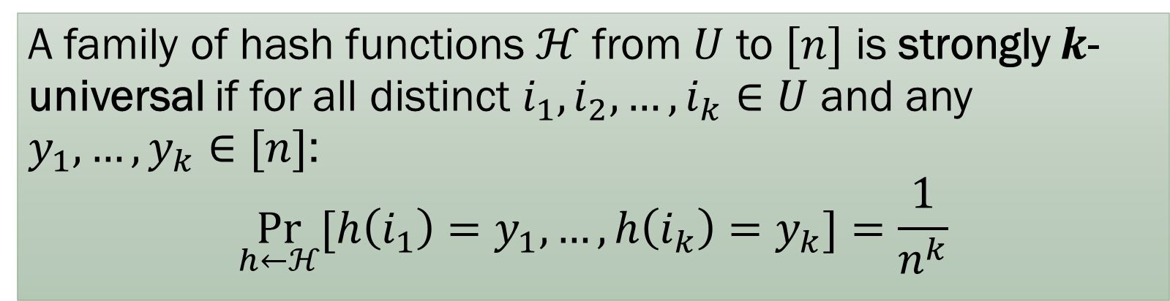
Strong Universality
A family of hash functions $ℋ$ from $U$ to $[n]$ is strongly $k$-universal if for all distinct $i_{1},i_{2},…, i_{k}∈U$ and any $y_{1},…, y_{k}∈[n]$:
$$\underset{h←ℋ}{Pr}{[h\left(i_{1}\right)=y_{1},…, h\left(i_{k}\right)=y_{k}}]=\frac{1}{n^{k}}$$
Strongly 2-universal families are also called pairwise independent hash families.

Slide 10
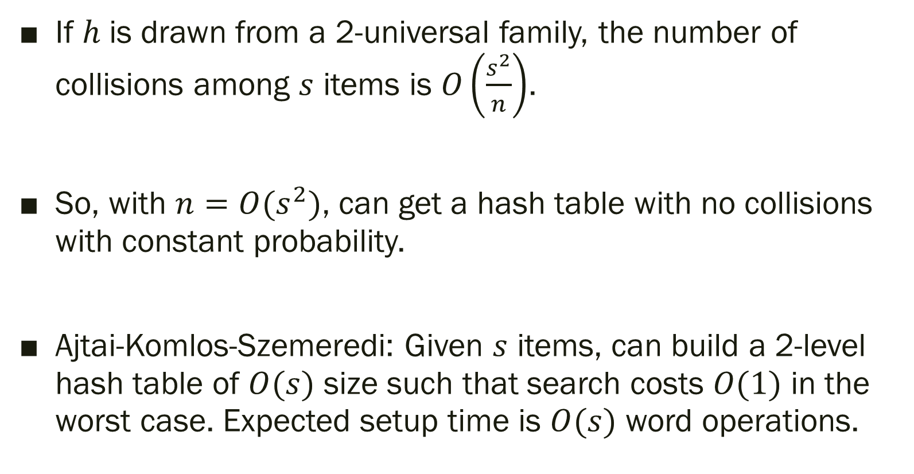
Consequences
If $h$ is drawn from a 2-universal family, the number of collisions among $s$ items is $O\left(\frac{s^{2}}{n}\right)$.
So, with $n=O(s^{2})$, can get a hash table with no collisions with constant probability.
Ajtai-Komlos-Szemeredi: Given $s$ items, can build a 2-level hash table of $O(s)$ size such that search costs $O(1)$ in the worst case. Expected setup time is $O(s)$ word operations.

Slide 11
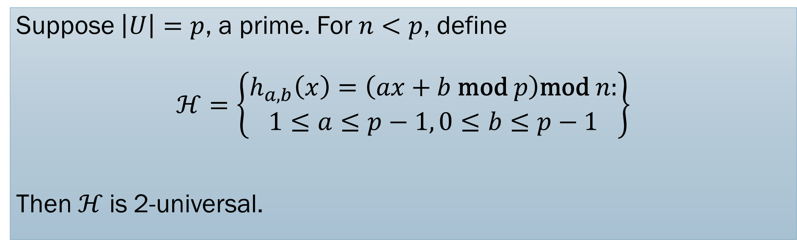
Explicit 2-universal families
Suppose $\left|U\right|=p$, a prime. For $n<p$, define
$$ℋ=\left\{\begin{aligned}h_{a,b}\left(x\right)=\left(ax+b \text{mod} p\right)\text{mod} n: \\ 1≤a≤p−1, 0≤b≤p−1\end{aligned}\right\}$$
Then$ℋ$is 2-universal.

Slide 12
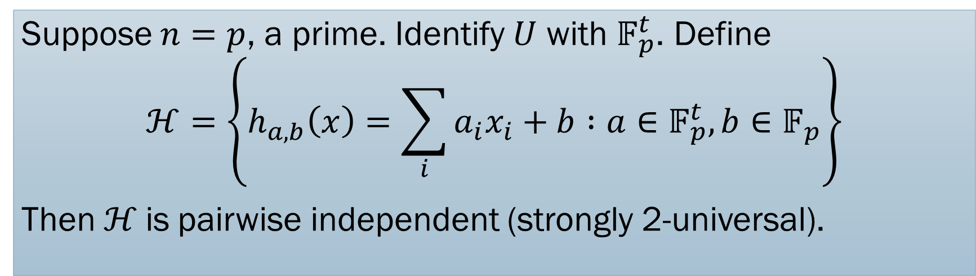
Explicit strongly 2-universal families
Suppose $n=p$, a prime. Identify $U$ with $𝔽_{p}^{t}$. Define
$$ℋ=\left\{h_{a,b}\left(x\right)=\sum_{i}{a_{i}x_{i}}+b :a∈𝔽_{p}^{t}, b∈𝔽_{p}\right\}$$
Then$ℋ$is pairwise independent (strongly 2-universal).

Slide 13
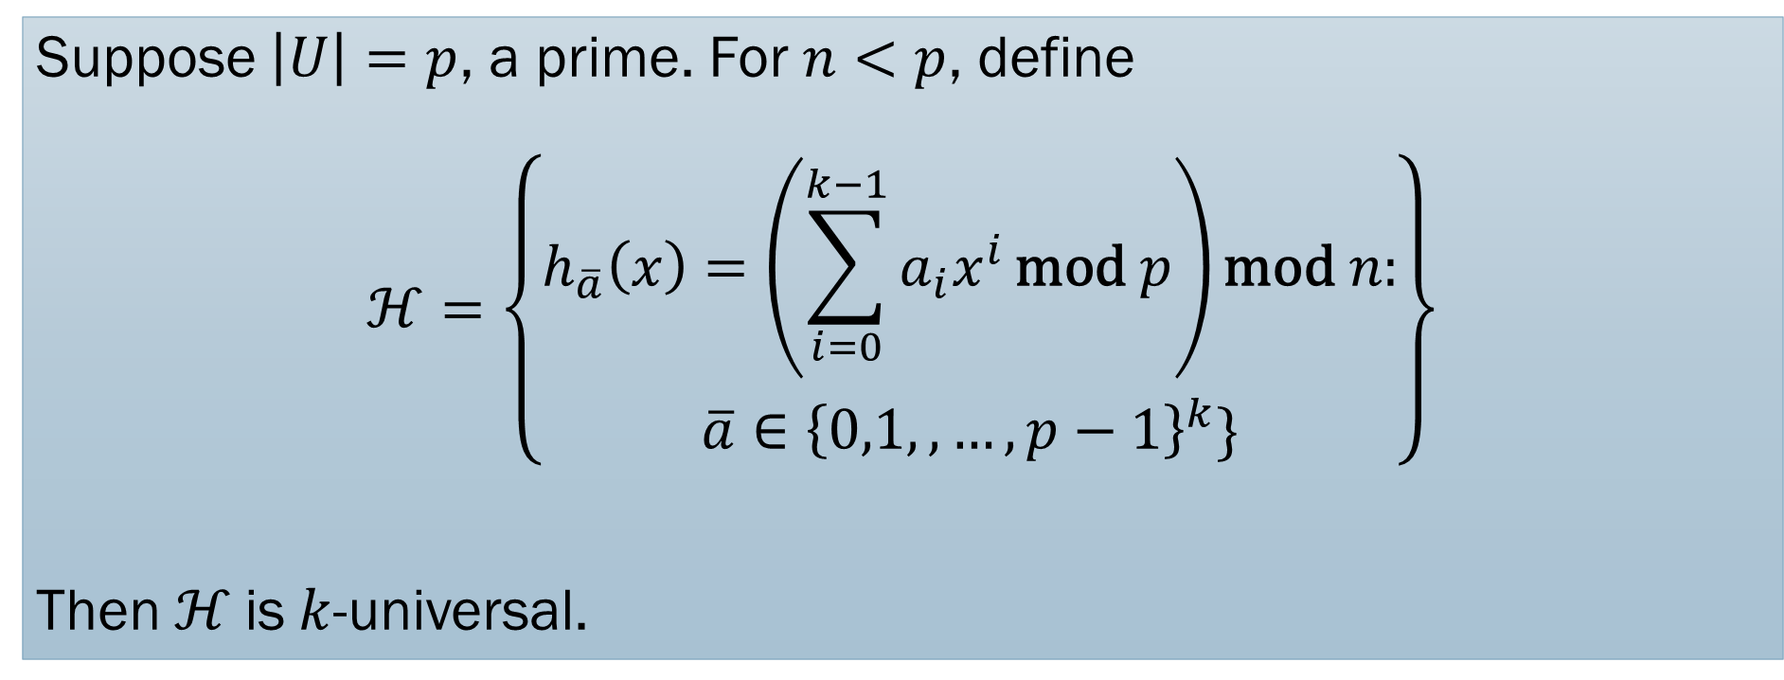
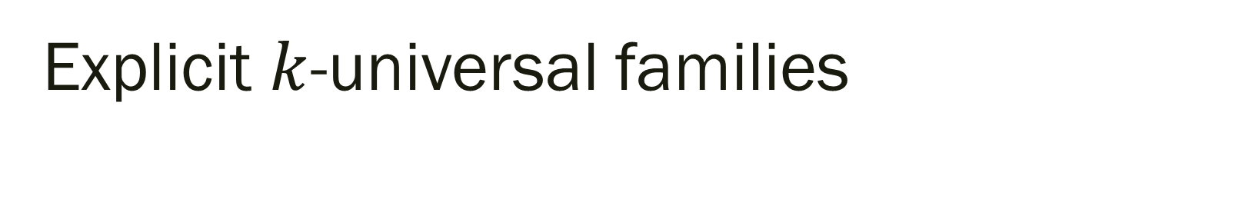
Explicit $k$-universal families
Suppose $\left|U\right|=p$, a prime. For $n<p$, define
$$ℋ=\left\{\begin{aligned}h_{\overline{a}}\left(x\right)=\left(\sum_{i=0}^{k−1}{a_{i}x^{i}}\text{mod} p\right)\text{mod} n: \\ \overline{a}∈{\left\{0,1,,…, p−1\right\}}^{k}\}\end{aligned}\right\}$$
Then$ℋ$is $k$-universal.

Slide 14
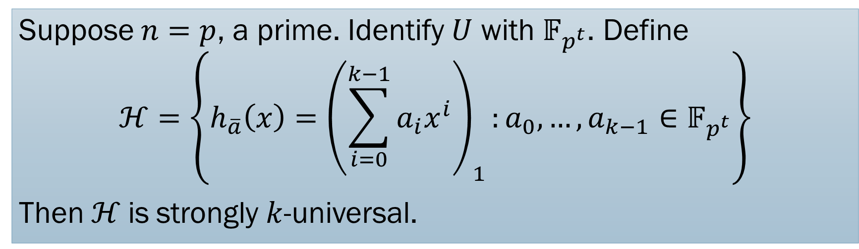
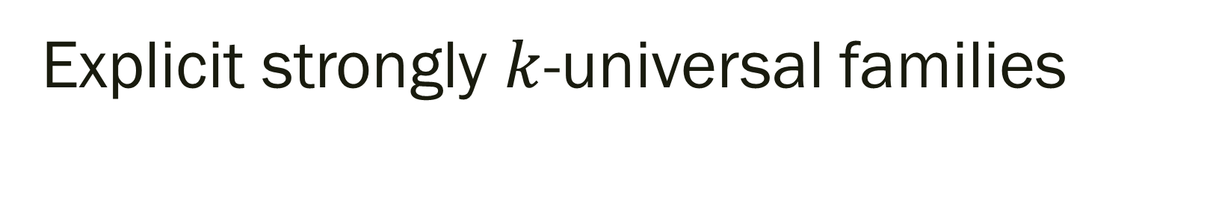
Explicit strongly $k$-universal families
Suppose $n=p$, a prime. Identify $U$ with $𝔽_{p^{t}}$. Define
$$ℋ=\left\{h_{\overline{a}}\left(x\right)={\left(\sum_{i=0}^{k−1}{a_{i}x^{i}}\right)}_{1}:a_{0}, …, a_{k−1}∈𝔽_{p^{t}}\right\}$$
Then$ℋ$is strongly $k$-universal.

Slide 15
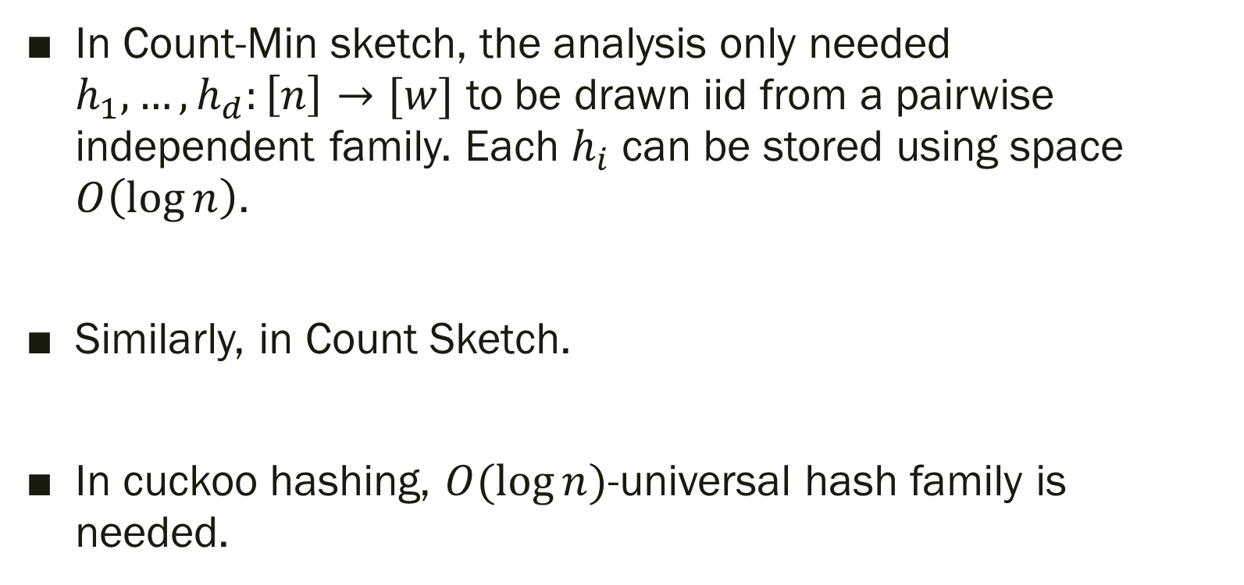
Applications
In Count-Min sketch, the analysis only needed $h_{1},…, h_{d}:\left[n\right]→[w]$ to be drawn iid from a pairwise independent family. Each $h_{i}$ can be stored using space $O\left(\log{n}\right)$.
Similarly, in Count Sketch.
In cuckoo hashing, $O(\log{n})$-universal hash family is needed.

Slide 16

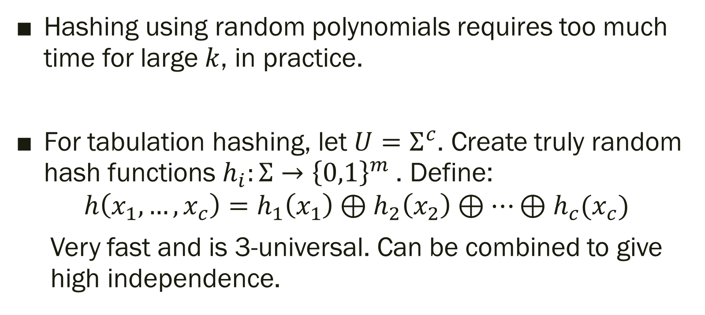
Tabulation
Hashing using random polynomials requires too much time for large $k$, in practice.
For tabulation hashing, let $U=Σ^{c}$. Create truly random hash functions $h_{i}:Σ→{\left\{0,1\right\}}^{m}$. Define:
$$h\left(x_{1},…, x_{c}\right)=h_{1}\left(x_{1}\right)⊕h_{2}\left(x_{2}\right)⊕⋯⊕h_{c}(x_{c})$$
Very fast and is 3-universal. Can be combined to give
high independence.

Slide 17
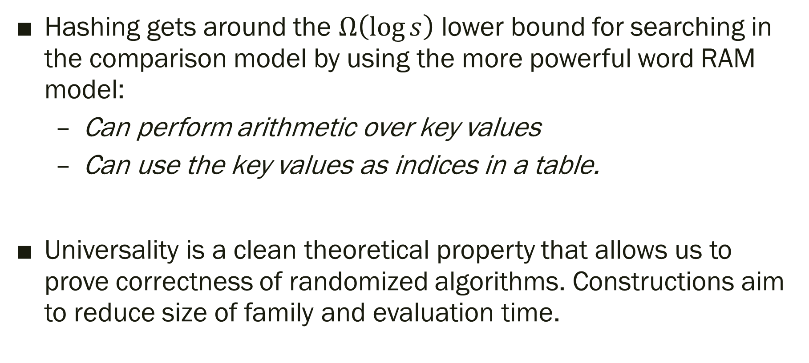
Takeaways
Hashing gets around the $Ω\left(\log{s}\right)$ lower bound for searching in the comparison model by using the more powerful word RAM model:
  Can perform arithmetic over key values
  Can use the key values as indices in a table.
Universality is a clean theoretical property that allows us to prove correctness of randomized algorithms. Constructions aim to reduce size of family and evaluation time.

Slide 18
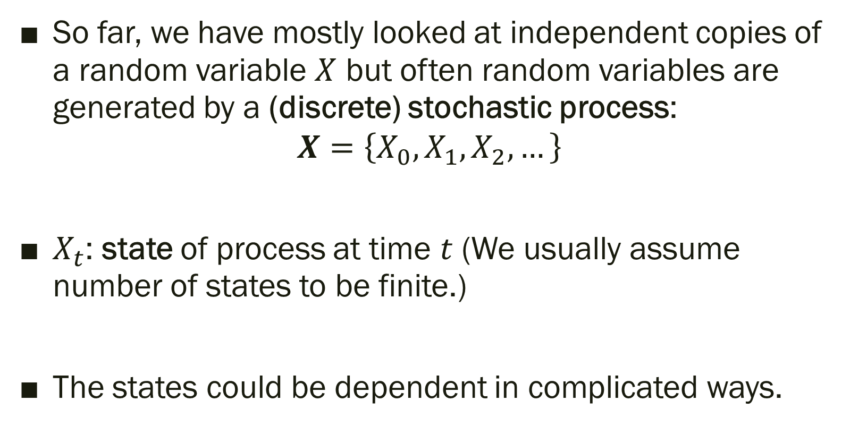
Stochastic Processes
So far, we have mostly looked at independent copies of a random variable $X$ but often random variables are generated by a (discrete) stochastic process:
$$X=\left\{X_{0}, X_{1},X_{2},…\right\}$$
$X_{t}$: state of process at time $t$ (We usually assume number of states to be finite.)
The states could be dependent in complicated ways.

Slide 19
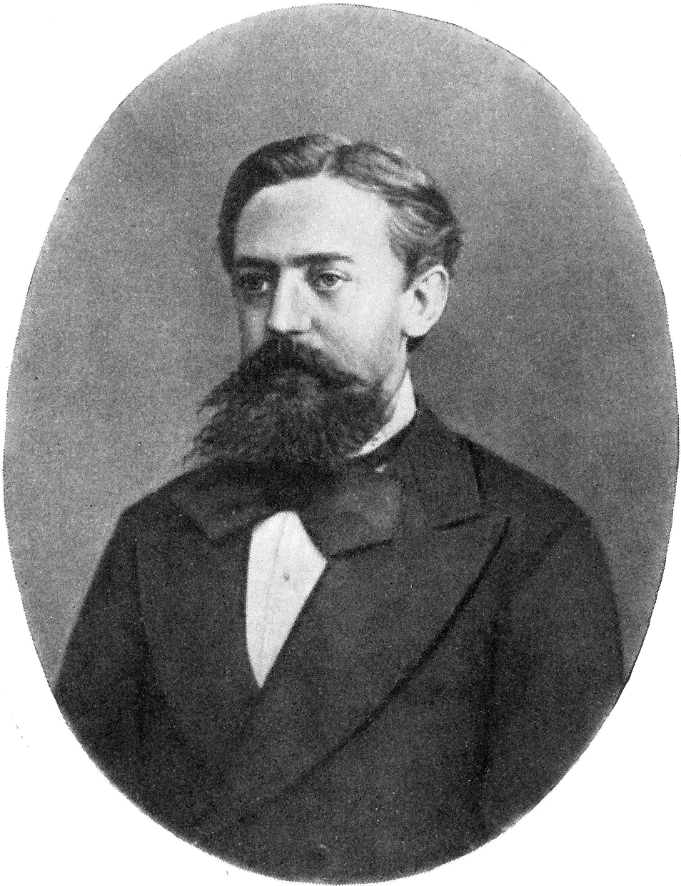
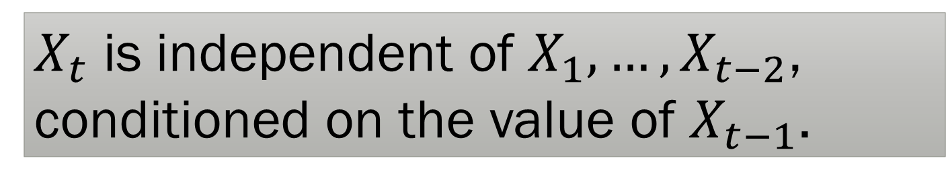
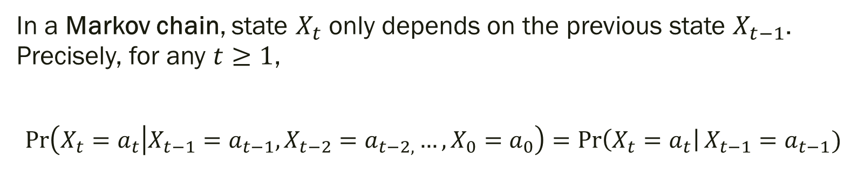
Markov Chains
In a Markov chain, state $X_{t}$ only depends on the previous state $X_{t−1}$. Precisely, for any $t≥1$,
$$\operatorname{Pr}\left(X_{t}=a_{t} | X_{t−1}=a_{t−1}, X_{t−2}=a_{t−2,}…, X_{0}=a_{0}\right)=\operatorname{Pr}\left(X_{t}=a_{t}\right|X_{t−1}=a_{t−1})$$
$X_{t}$ is independent of $X_{1},…, X_{t−2}$, conditioned on the value of $X_{t−1}$.

Slide 20
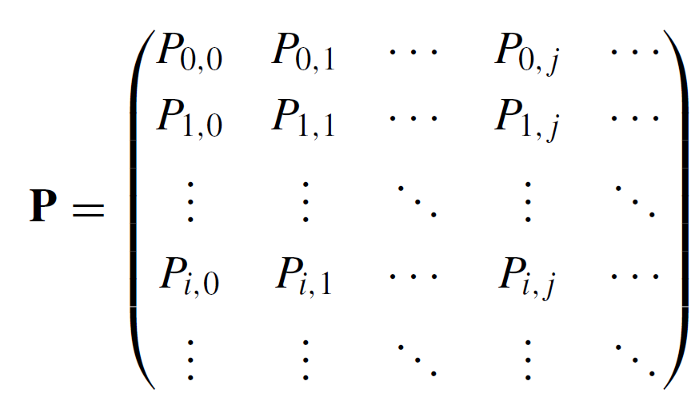
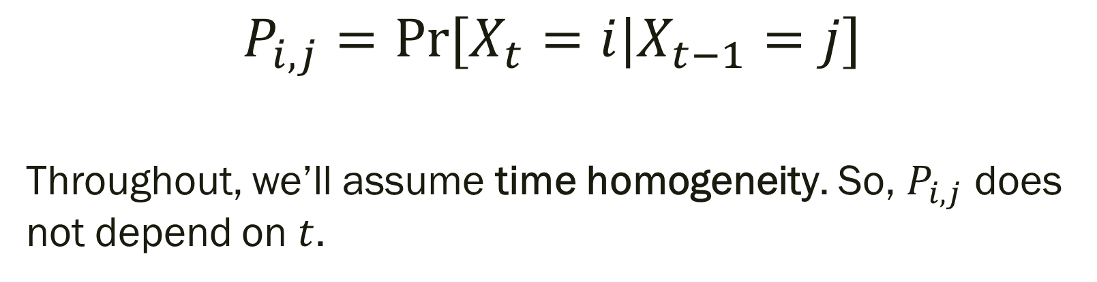
Transition Matrix
$$P_{i,j}=Pr⁡[X_{t}=i|X_{t−1}=j]$$
Throughout, we’ll assume time homogeneity. So, $P_{i,j}$ does not depend on $t$.
Transition Matrix

Slide 21
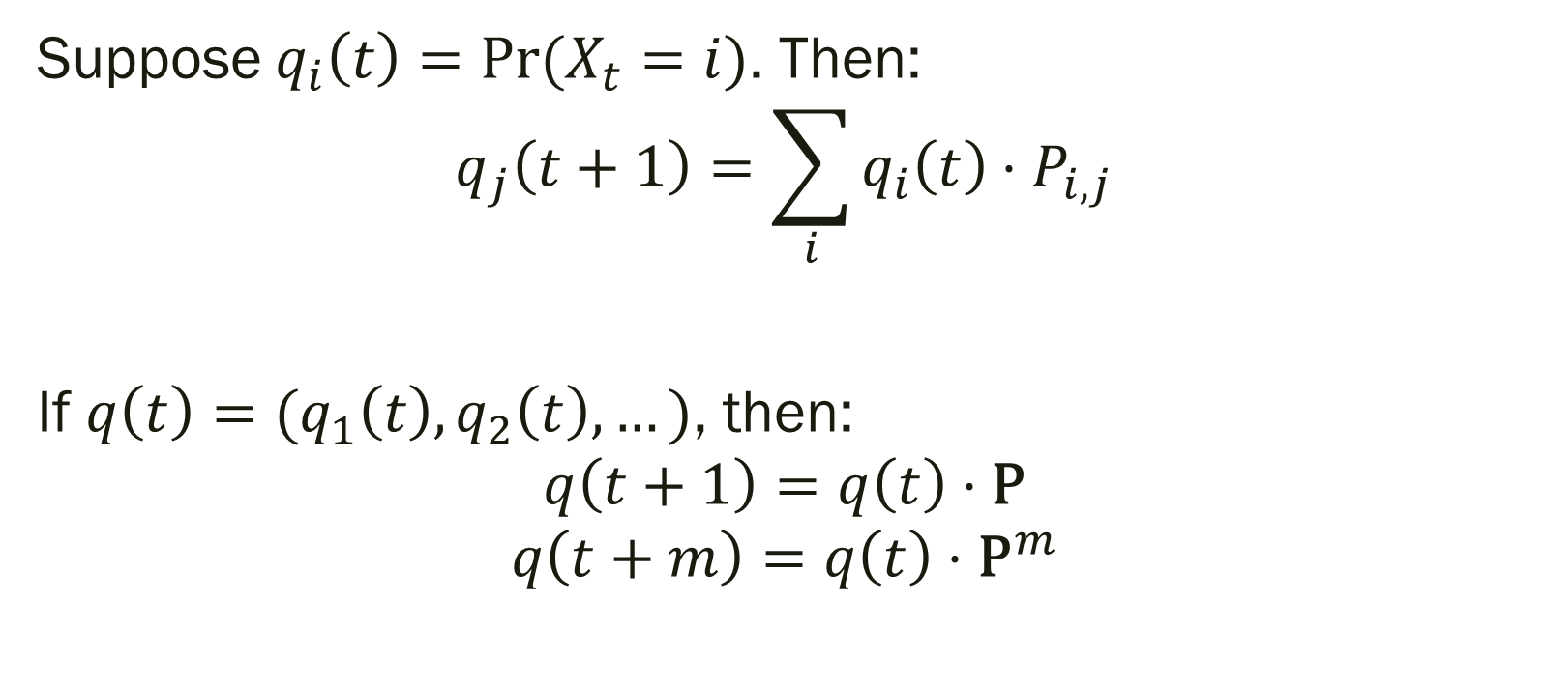
Updating probabilities
Suppose $q_{i}\left(t\right)=Pr⁡(X_{t}=i)$. Then:
$$q_{j}\left(t+1\right)=\sum_{i}{q_{i}\left(t\right)⋅P_{i,j}}$$
If $q\left(t\right)=(q_{1}\left(t\right), q_{2}\left(t\right), …)$, then:
$$q\left(t+1\right)=q\left(t\right)⋅\text{P}$$
$$q\left(t+m\right)=q\left(t\right)⋅{\text{P}}^{m}$$

Slide 22
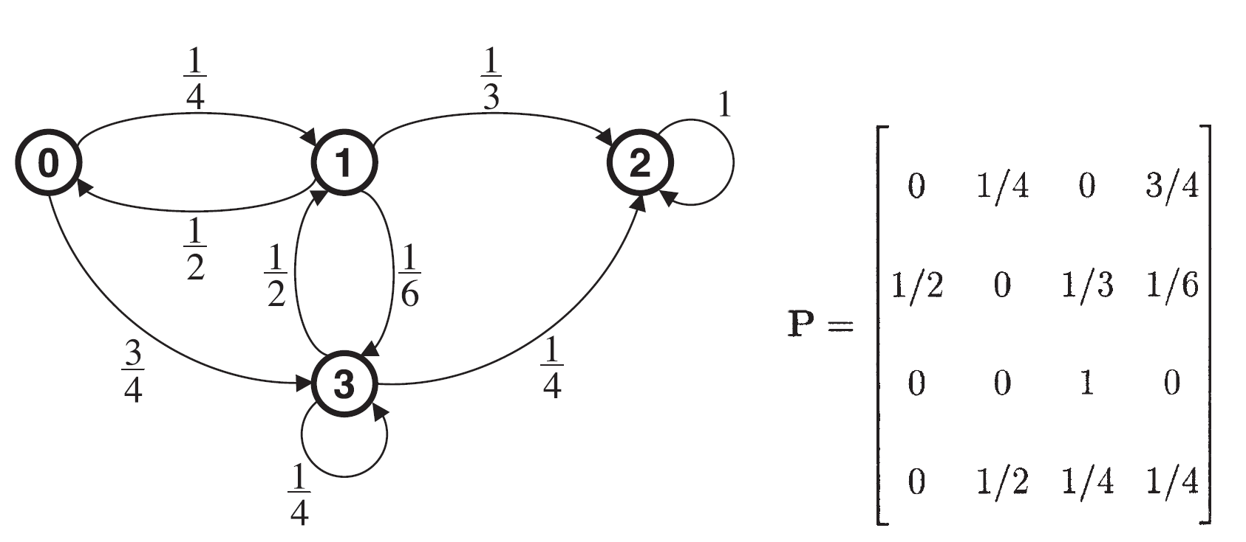
What is the probability of going from state 0 to state 3 in exactly 3 steps?

Slide 23
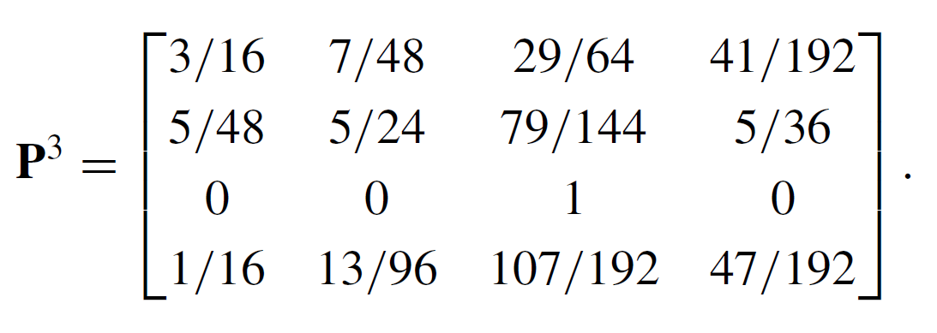


Slide 24
Markov Chains for Search Problems
Set up a Markov chain in which one of the states is your goal.
Show that the process reaches the goal state with decent probability.

Slide 25
2-SAT
2-SAT is the following Boolean constraint satisfaction problem:
Given a list of clauses, each a disjunction (OR) of at most two literals, find an assignment satisfying all of them.
Possible strategy: start with an initial assignment, look for a clause that is not satisfied, change the assignment to satisfy that clause, repeat.

Slide 26
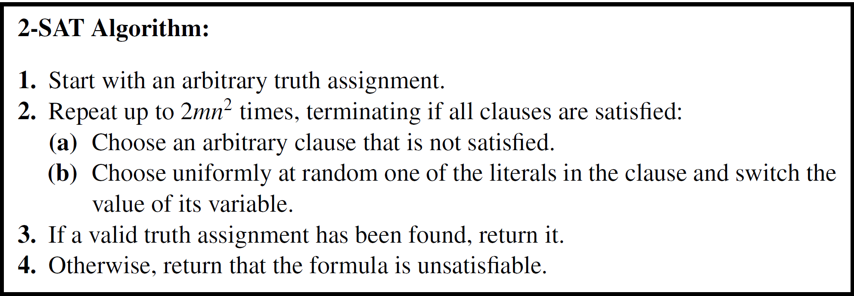
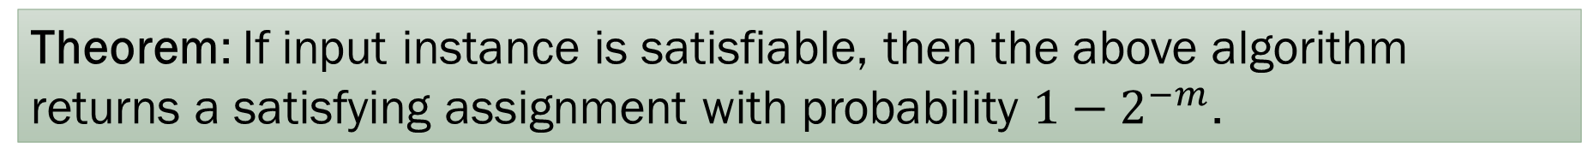
Theorem: If input instance is satisfiable, then the above algorithm returns a satisfying assignment with probability $1−2^{−m}$.

Slide 27
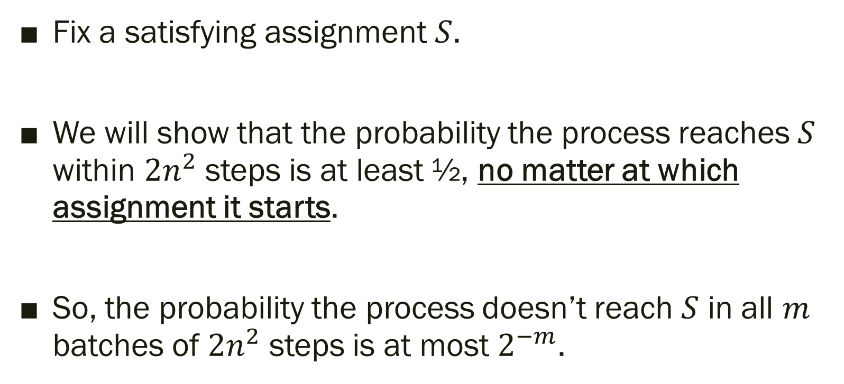
Sketch of Analysis
Fix a satisfying assignment $S$.
We will show that the probability the process reaches $S$ within $2n^{2}$ steps is at least ½, no matter at which assignment it starts.
So, the probability the process doesn’t reach $S$ in all $m$ batches of $2n^{2}$ steps is at most $2^{−m}$.

Slide 28
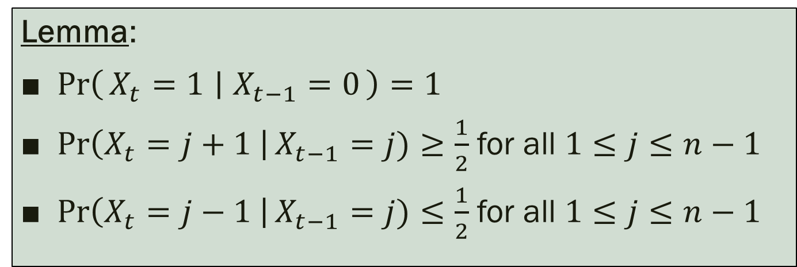
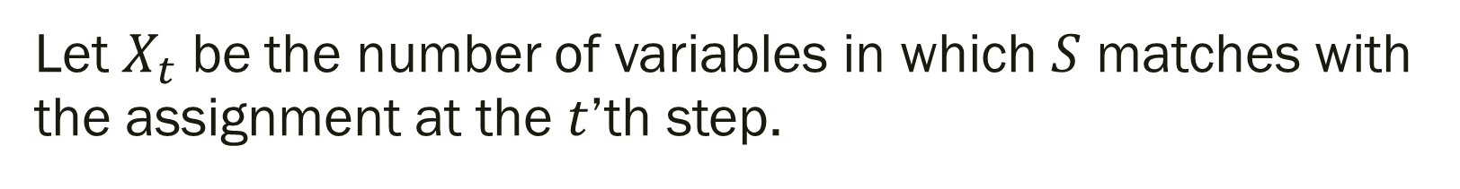
The process
Let $X_{t}$ be the number of variables in which $S$ matches with the assignment at the $t$’th step.
Lemma:
$\operatorname{Pr}\left(X_{t}=1 ∣ X_{t−1}=0\right)=1$
$\operatorname{Pr}\left(X_{t}=j+1 \right|X_{t−1}=j)≥\frac{1}{2}$ for all $1≤j≤n−1$
$\operatorname{Pr}\left(X_{t}=j−1 \right|X_{t−1}=j)≤\frac{1}{2}$ for all $1≤j≤n−1$
Note: The process $(X_{0},X_{1},…)$ may not be a Markov chain.

Slide 29



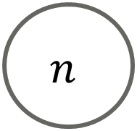






$$≤0.5$$
$$≤0.5$$
$$≤0.5$$
$$≤0.5$$
$$≤0.5$$
0
1
2
3
$$n$$
1
$$≥0.5$$
$$≥0.5$$
$$≥0.5$$
$$≥0.5$$
How long does it take to reach $n$ (starting from an arbitrary state)?

Slide 30









$$0.5$$
$$0.5$$
$$0.5$$
$$0.5$$
$$0.5$$
0
1
2
3
$$n$$
1
$$0.5$$
$$0.5$$
$$0.5$$
$$0.5$$
How long does it take to reach $n$ (starting from an arbitrary state)?

Slide 31
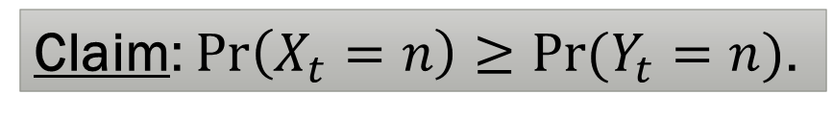
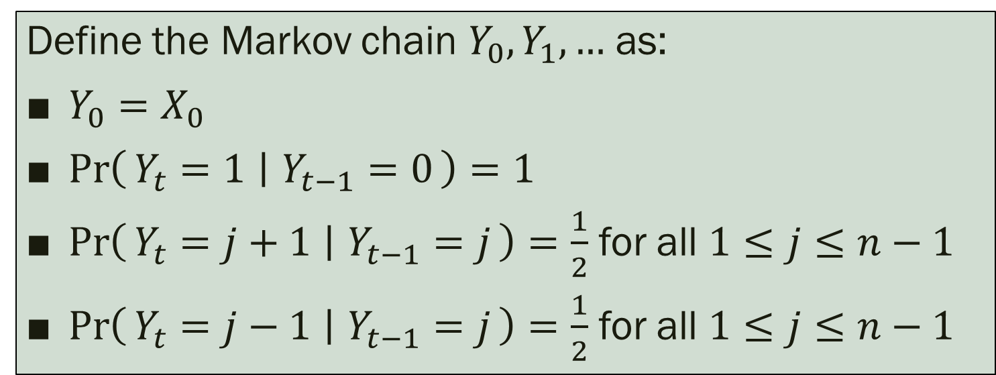
The Markov Chain
Define the Markov chain $Y_{0},Y_{1},…$ as:
$Y_{0}=X_{0}$
$\operatorname{Pr}\left(Y_{t}=1 ∣ Y_{t−1}=0\right)=1$
$\operatorname{Pr}\left(Y_{t}=j+1 ∣ Y_{t−1}=j\right)=\frac{1}{2}$ for all $1≤j≤n−1$
$\operatorname{Pr}\left(Y_{t}=j−1 ∣ Y_{t−1}=j\right)=\frac{1}{2}$ for all $1≤j≤n−1$
Claim: $\operatorname{Pr}\left(X_{t}=n\right)≥\operatorname{Pr}{(Y_{t}=n)}$.

Slide 32
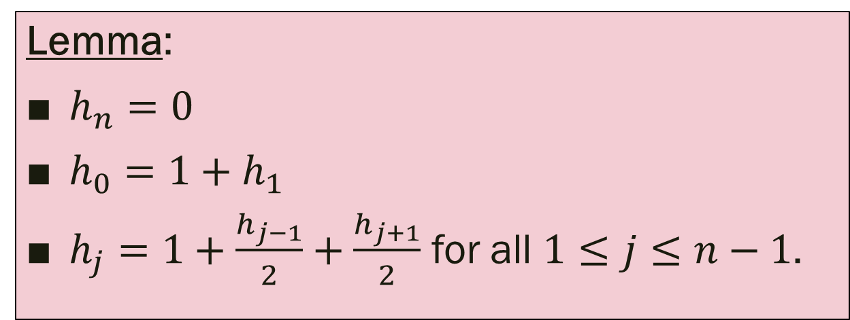
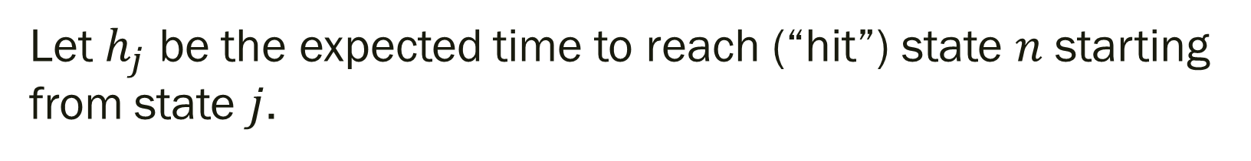
Bounding the hitting time
Let $h_{j}$ be the expected time to reach (“hit”) state $n$ starting from state $j$.
Lemma:
$h_{n}=0$
$h_{0}=1+h_{1}$
$h_{j}=1+\frac{h_{j−1}}{2}+\frac{h_{j+1}}{2}$ for all $1≤j≤n−1$.

Slide 33
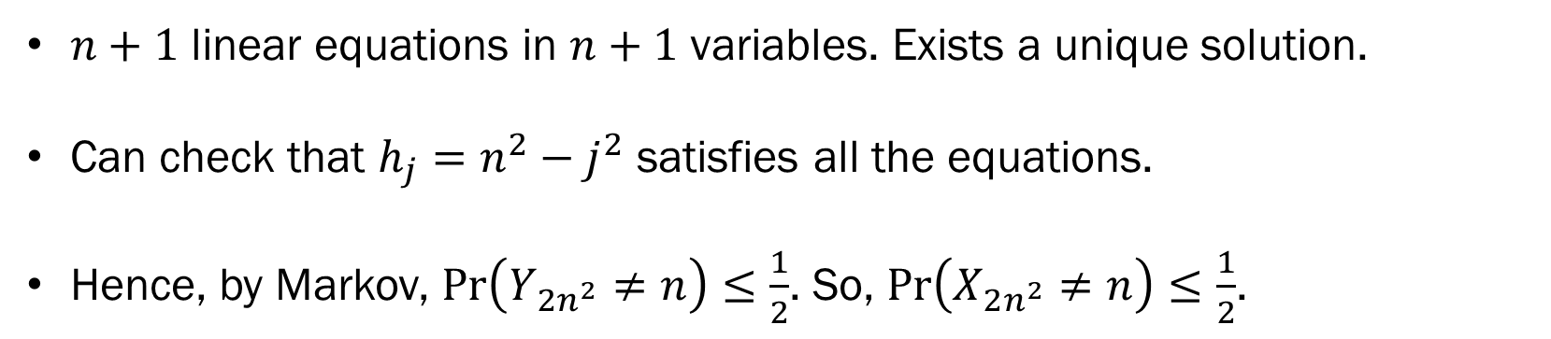
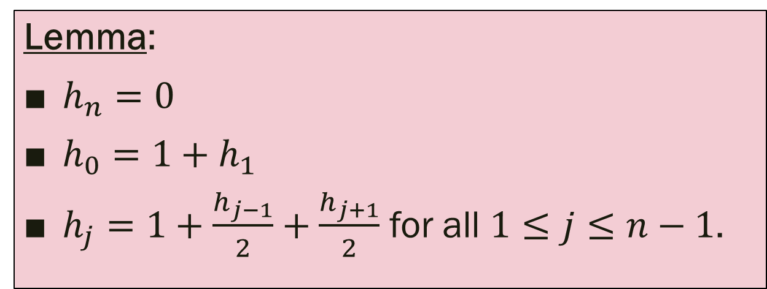
Bounding the hitting time
Lemma:
$h_{n}=0$
$h_{0}=1+h_{1}$
$h_{j}=1+\frac{h_{j−1}}{2}+\frac{h_{j+1}}{2}$ for all $1≤j≤n−1$.
$n+1$ linear equations in $n+1$ variables. Exists a unique solution.
Can check that $h_{j}=n^{2}−j^{2}$ satisfies all the equations.
Hence, by Markov, $\operatorname{Pr}\left(Y_{2n^{2}}≠n\right)≤\frac{1}{2}$. So, $\operatorname{Pr}\left(X_{2n^{2}}≠n\right)≤\frac{1}{2}$.

Slide 34
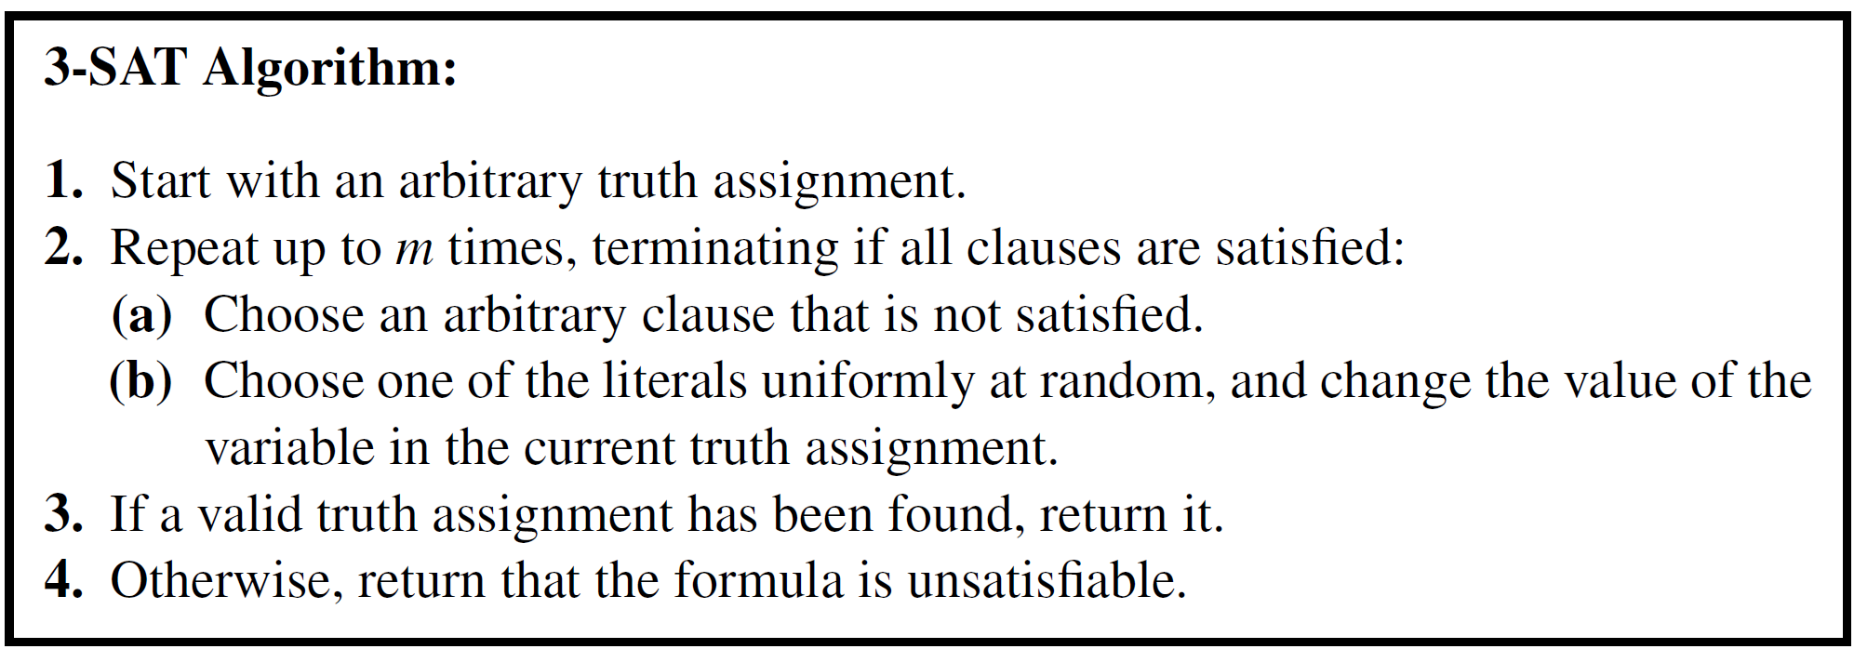
3-SAT?
What goes wrong?

Slide 35
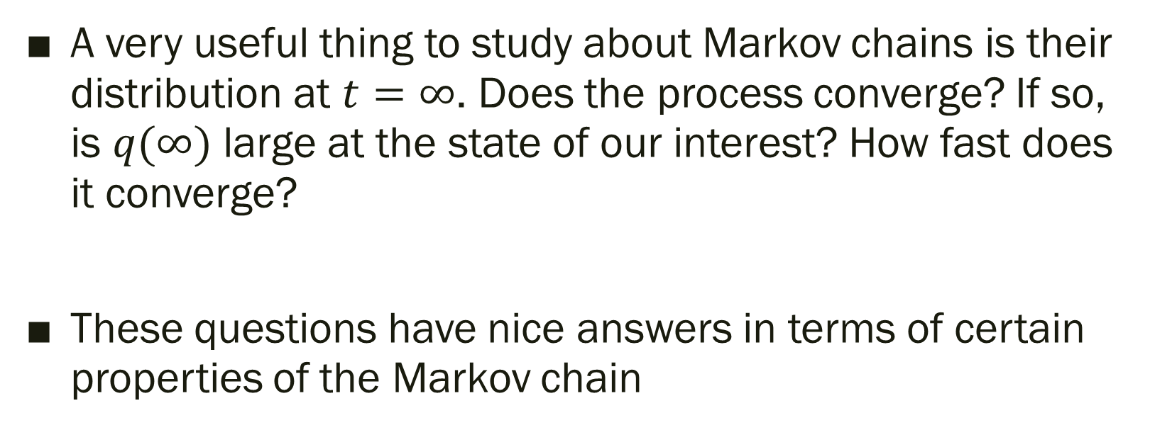

Towards $q\left(∞\right)$
A very useful thing to study about Markov chains is their distribution at $t=∞$. Does the process converge? If so, is $q(∞)$ large at the state of our interest? How fast does it converge?
These questions have nice answers in terms of certain properties of the Markov chain

Slide 36
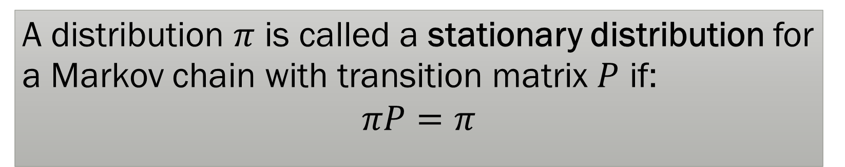
Stationary Distribution
A distribution $π$ is called a stationary distribution for a Markov chain with transition matrix $P$ if:
$$πP=π$$
Questions: Is there always a stationary distribution? Can there be many stationary distributions? Does the Markov chain always reach a stationary distribution? Is there convergence? What do they look like?

Slide 37

Existence of $π$
Theorem: Every finite state Markov chain has a stationary distribution.
There can be many though…For example, union of two Markov chains on disjoint state spaces.

Slide 38
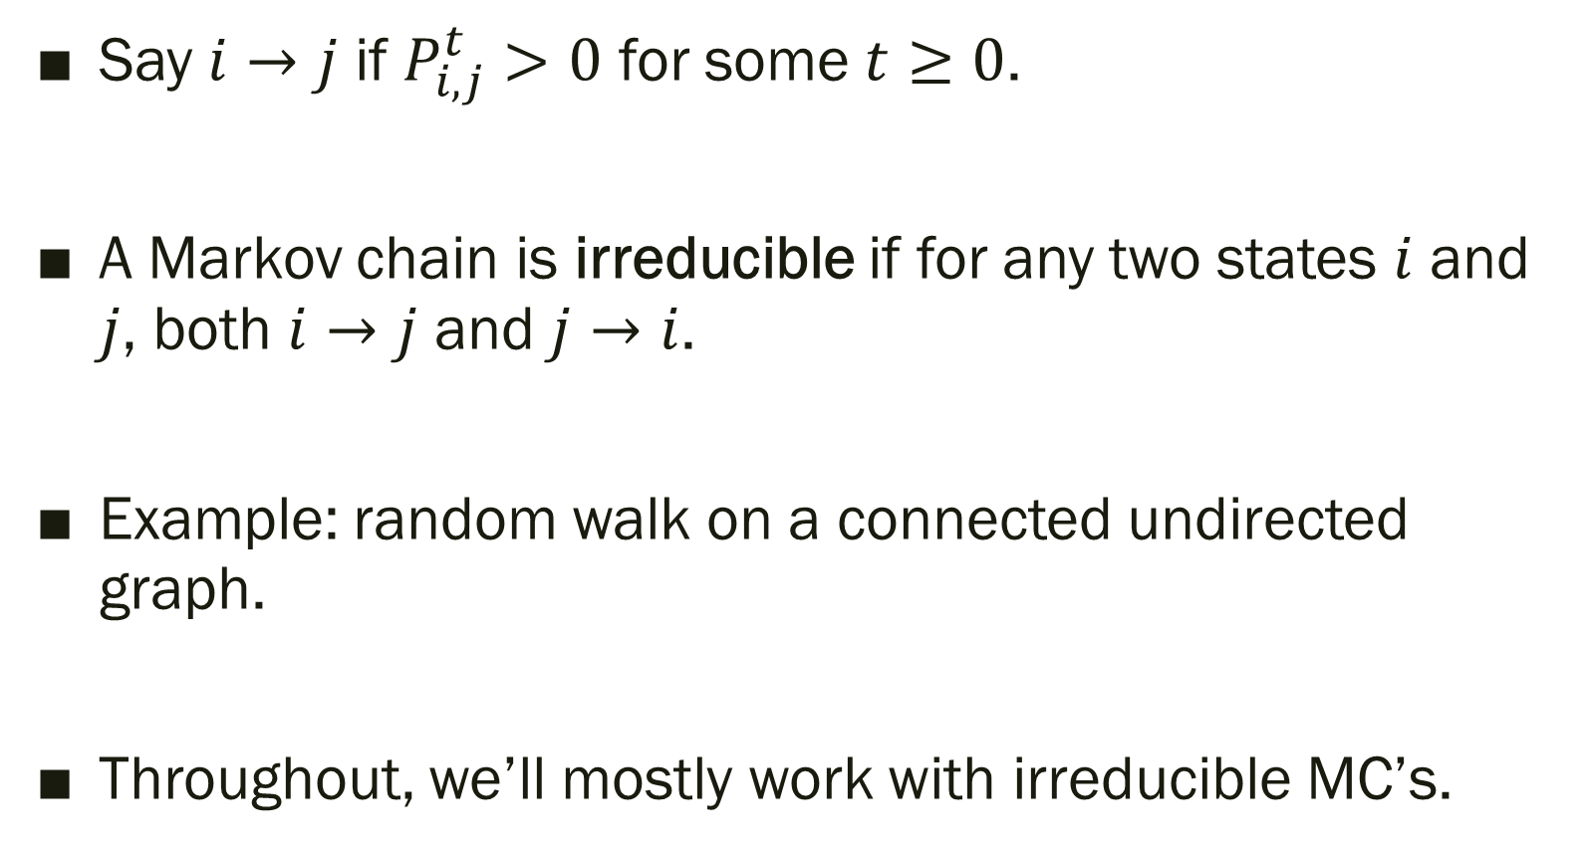
Irreducibility
Say $i→j$ if $P_{i,j}^{t}>0$ for some $t≥0$.
A Markov chain is irreducible if for any two states $i$ and $j$, both $i→j$ and $j→i$.
Example: random walk on a connected undirected graph.
Throughout, we’ll mostly work with irreducible MC’s.

Slide 39

Uniqueness of $π$
Theorem: Every finite state irreducible Markov chain has exactly one stationary distribution.
Okay, what is it?

Slide 40
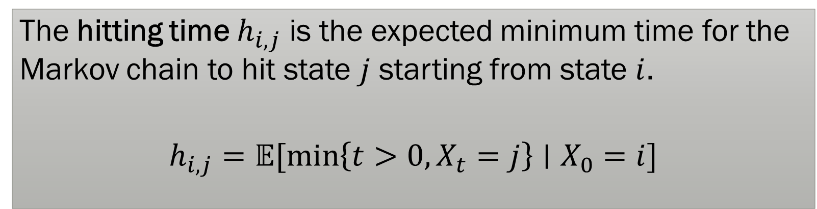
Hitting Time
The hitting time $h_{i,j}$ is the expected minimum time for the Markov chain to hit state $j$ starting from state $i$.
$$h_{i,j}=𝔼[\min\left\{t>0, X_{t}=j\right\}∣X_{0}=i]$$

Slide 41
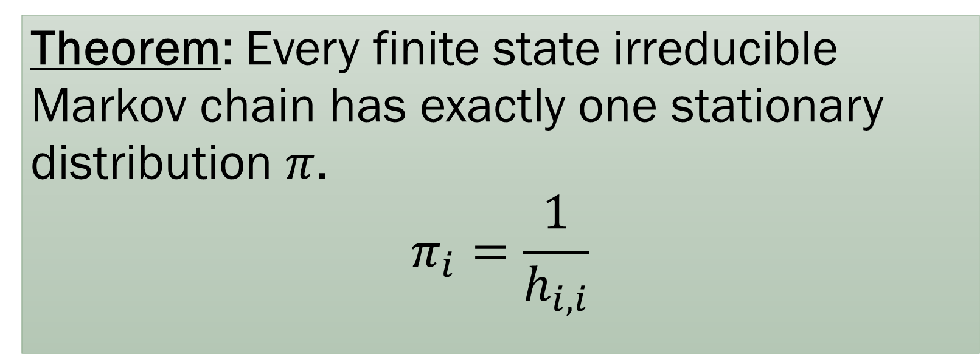
Uniqueness of $π$
Theorem: Every finite state irreducible Markov chain has exactly one stationary distribution $π$.
$$π_{i}=\frac{1}{h_{i,i}}$$

Slide 42


Convergence?
$$1$$
1
2
$$1$$
States oscillate between 1 and 2. No convergence!

Slide 43
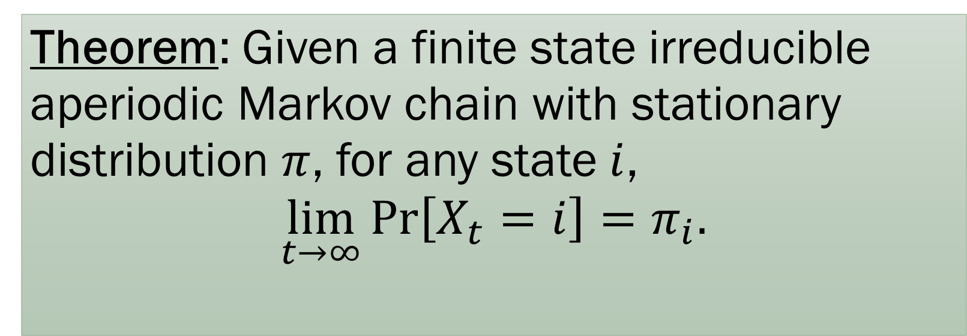

Convergence
A Markov chain is aperiodic if for all states $i$,
$$\gcd\left(\left\{t:P_{i,i}^{t}>0\right\}\right)=1$$
Theorem: Given a finite state irreducible aperiodic Markov chain with stationary distribution $π$, for any state $i$,
$$\lim_{t→∞}{\operatorname{Pr}\left[X_{t}=i\right]}=π_{i}.$$

Slide 44
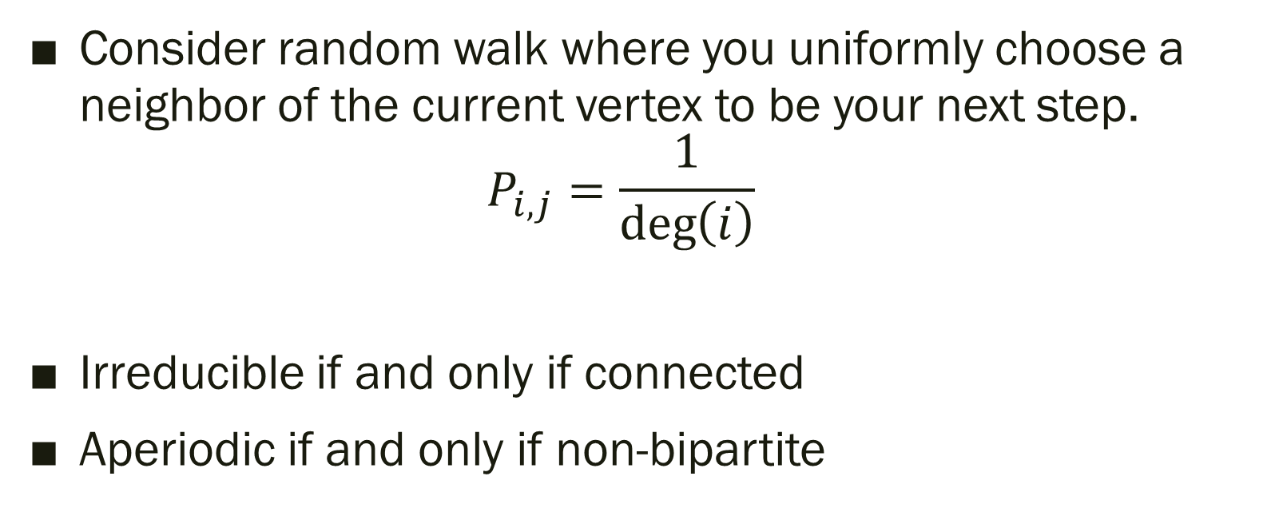
Random walk on undirected graph
Consider random walk where you uniformly choose a neighbor of the current vertex to be your next step.
$P_{i,j}=\frac{1}{\deg\left(i\right)}$
Irreducible if and only if connected
Aperiodic if and only if non-bipartite

Slide 45
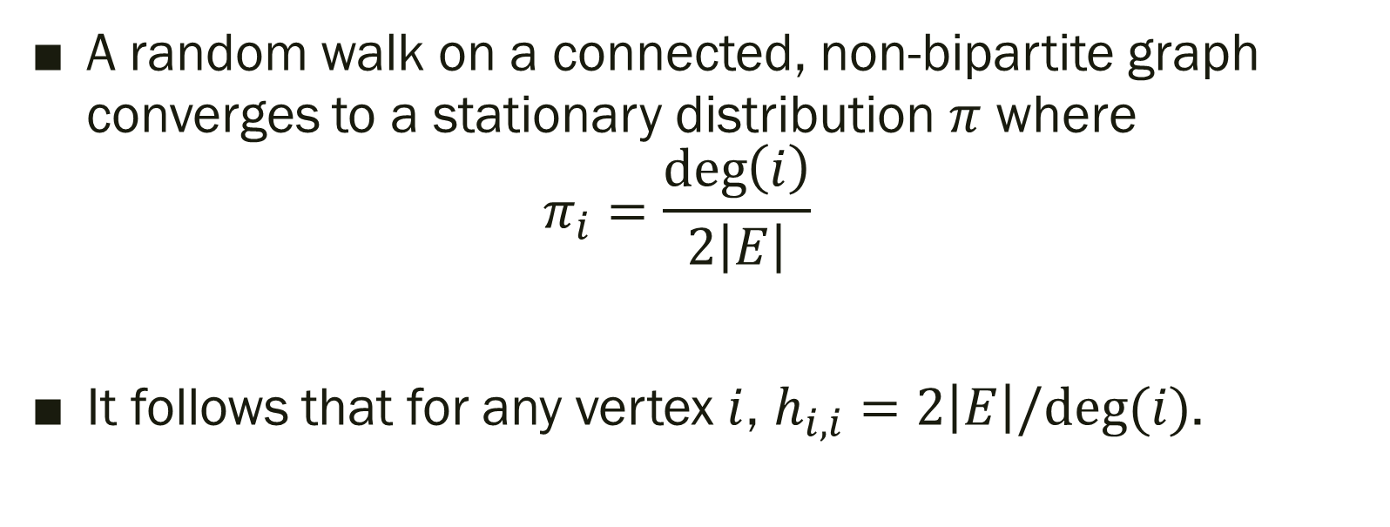
Stationary Distribution
A random walk on a connected, non-bipartite graph converges to a stationary distribution $π$ where
$π_{i}=\frac{\deg\left(i\right)}{2\left|E\right|}$
It follows that for any vertex $i$, $h_{i,i}=2\left|E\right|/deg⁡(i)$.

Slide 46

Hitting Time and Cover Time
Recall:
$h_{i,j}=𝔼[\min\left\{t>0:X_{t}=j\right\}∣X_{0}=i]$
The cover time is the maximum over all vertices $v$ of the expected time to visit all of the nodes in a graph by a random walk starting from $v$.

Slide 47

Examples
If $G=K_{n}$, $h_{i,j}=n$ and the cover time is $O\left(n\log{n}\right)$ [“coupon collector”]
If $G$ is the path of length $n$, then the cover time is $O(n^{2}$), as we already saw.
If $G$ is the “lollipop graph” with a $u$ participating in both a clique of size $n/2$ and a disjoint path of length $n/2$ ending in $v$, then $h_{v,u}=O\left(n^{2}\right),$ $h_{u,v}=O(n^{3})$, and the cover time is $O(n^{3})$.

Slide 48

Next Time
We will bound the cover time of random walks on any undirected graph by $O\left(n^{3}\right)$. Lollipops are the worst!
We will see another application of Markov chains: MCMC algorithms.

